Slide 1

Çankaya university faculty of engineering
CENG 408 PROJECT PRESENTATION
COMPUTER ENGINEER DEPARTMENT
AUTO DAMAGED FOLLOWING SYSTEM
BENGİ DEMİRSAHAN
MUSTAFA DEMİRMAN
TAHSİN KILINÇARSLAN
ADVISOR : ERDOĞAN DOĞDU

Slide 2
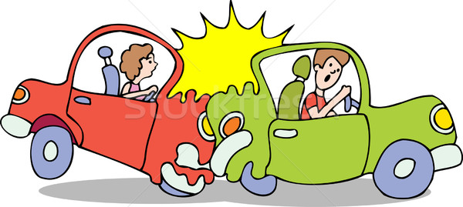
Introduction
This auto tracking system will be technologically beneficial to the user as well as to the company and company of auto managers. The damage repair section will follow the damage to the vehicle and issue a barcode that the expertise system has entered via the database system with mobile devices.

Slide 3
Introduction
The barcode which convey the information to database of the tracking system about car on a car provides accessibility for information about damaged or normal cars. This situation have many advantages in terms of customers, insurance companies and company of managers.

Slide 4


Introduction
For example, Auto King is the biggest auto damage tracking system in Turkey. The biggest difference between this system and our system is to follow the workflow with the barcode system.
Yüce Yazılım is the same as the workflow from our system but they work with the appointment system.

Slide 5
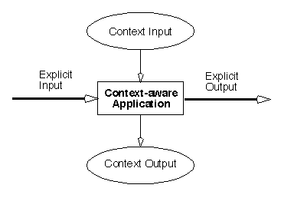
What Are These Criteria’s?
This application was developed according to the context awareness system. Context aware systems are gathered in the data related to the auto and this information is evaluated by the company and the transaction is carried out accordingly.

Slide 6

What Are These Criteria’s?
This consciousness is part of the price and the vehicle. According to the damage status of the car, the customer tells which part will change and the estimated cost.

Slide 7
What Are These Criteria’s?
It is a criterion for us to make the accident happen once. According to the criteria, parts of the vehicle to be replaced are determined. The company also follows the repair phase.

Slide 8
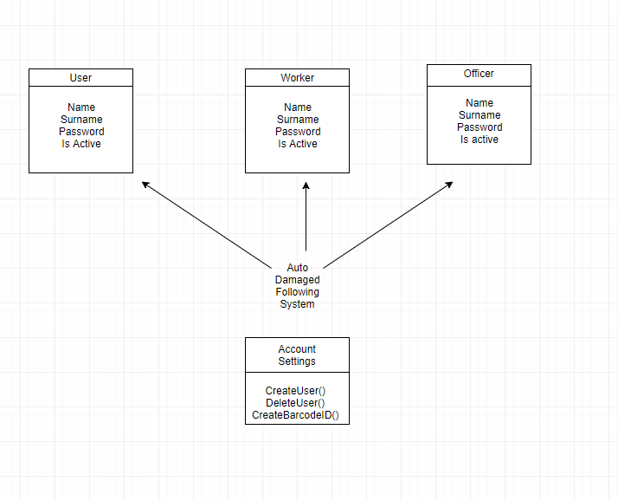
How does our algorithm Works?
Our system takes informations about people.According to these information, system can understand ranks of people.

Slide 9
How does our algorithm Works?
If user does not exist, the new user is created. Else If it exists, the user enter username and password and the system will open.
Button button4 = (Button) rootview.findViewById(R.id.button4); button4.setOnClickListener(new View.OnClickListener() { public void onClick(View v) { FragmentManager fm = getFragmentManager(); FragmentTransaction ft = fm.beginTransaction(); AracKaydi llf2 = new AracKaydi(); ft.replace(R.id.content_frame, llf2); ft.commit(); } }); Button button5 = (Button) rootview.findViewById(R.id.button5); button5.setOnClickListener(new View.OnClickListener() { public void onClick(View v) { FragmentManager fm = getFragmentManager(); FragmentTransaction ft = fm.beginTransaction(); KayitliArac llf2 = new KayitliArac(); ft.replace(R.id.content_frame, llf2); ft.commit(); } });

Slide 10
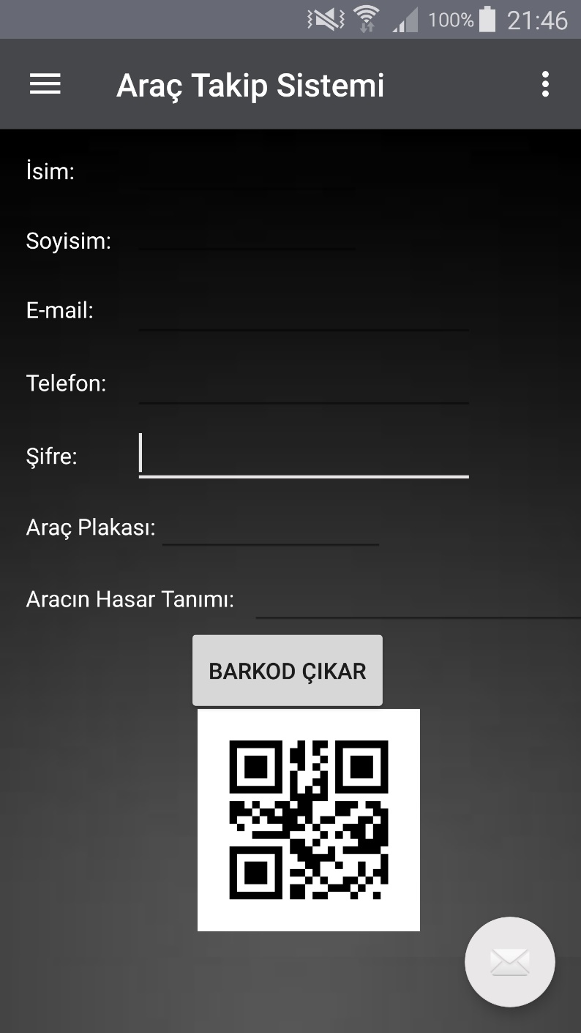
How does our algorithm Works?
The officer create an user and barcode ID.Then enter accident information.After the repair, the user enter renew tools of auto and the payment will calculate automatically.

Slide 11
How does our algorithm Works?
The worker reads barode ID and enter the status of damaged auto.
The worker enter estimated remaining time.
When the car is ready inform the officer.

Slide 12
How does our algorithm Works?
The user follow status of the car.The user can follow estimated remaining time,total payment.

Slide 13
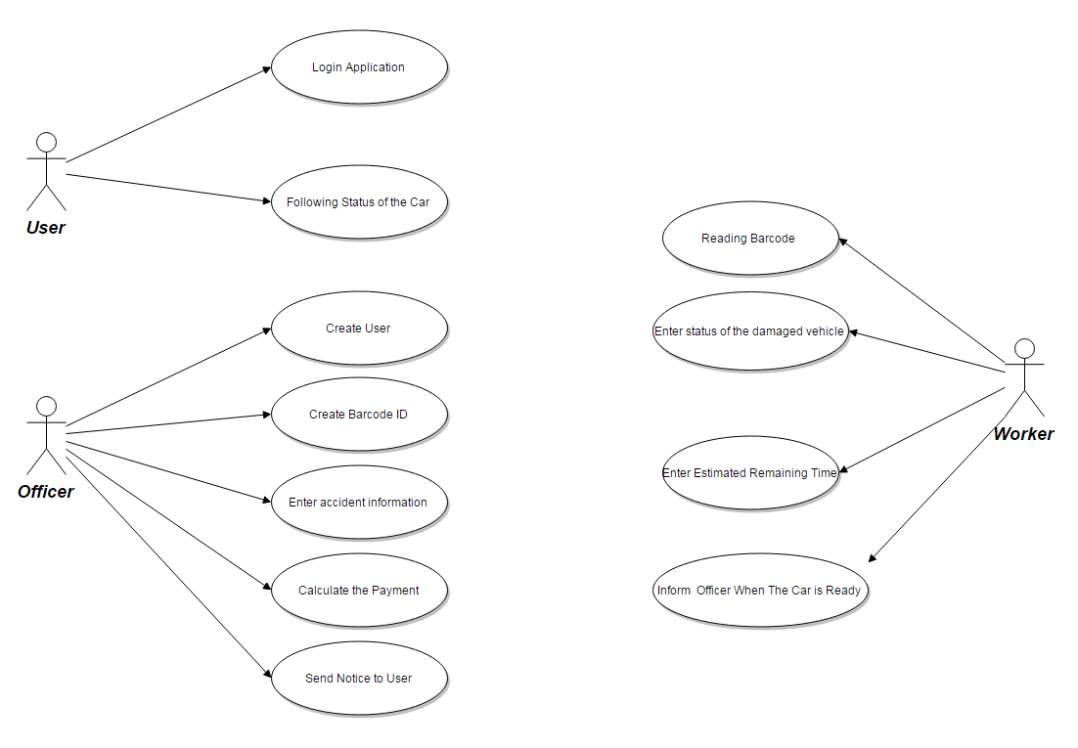
How does our algorithm Works?
Flowchart of Application

Slide 14


which technologies did we use?
In this project, we used android studio for user interface. We used firebase for android services to store all data.

Slide 15
